Slide 1
CHURN PREDICTION
700747032 – Sai Charan Yadavelli
700747449 – Sai Prakash Podapati
700746287 – Sai Snusha Nakka

Slide 2
OVERVIEW
01
04
Proposed Solution
Motivation
02
05
Related Works
Objective
03
Problem Statement and Introduction
06
Results & Conclusion

Slide 3
MOTIVATION
The main motivation of Churn prediction is to detect which customers are likely to leave a service or cancel a subscription to a service.
This provides businesses with a proactive approach to identify customers who are at a high risk of churning. So, that allows them to take timely actions to retain customer churn.
Resource optimization is used to predict the user by prioritizing churn prediction by allocating market budgets, customer service efforts and product improvements.
Gaining competitive advantage by allowing them to proactively address customer churn. By outperforming their competitors.

Slide 4


OBJECTIVE
Primary objective of the customer churn predictive model is to retain customers at the highest risk of churn by proactively engaging with them.
Early Identification of churn this allows businesses to take proactive measures to retain these customers, by offering personalised offers, target promotions or by improving customer service.
And also finding target columns, extracting the right feature extraction.

Slide 5
PROBLEM STATEMENT
Churn Analysis Churn (loss of customers to competition) is a problem for companies because it is expensive to acquire a new customer and companies want to retain their existing customers. Most telecom companies suffer from voluntary churn
Businesses are very keen on measuring churn because keeping an existing customer is far less expensive than acquiring a new customer.
New business involves working leads through a sales funnel, using marketing and sales budgets to gain additional customers. Existing customers will often have a higher volume of service consumption and can generate additional customer referrals.

Slide 6
SOLUTION
ANN’s are a type of DL model that can be used to make predictions based on patterns learned from large datasets
Retrieve data from online sources such as Kaggle. Gather a labelled dataset that includes features and corresponding churn levels
Define the architecture of ANN In this we define the number of layers and epochs. This includes specifying the number of layers, the type of activation functions, and number of neurons in each layer
Experiment with different architecture to find the one that performs best for your specific dataset.

Slide 7
SOLUTION
Compile ANN by specifying the optimizer, loss function, evaluation metrics.
Train ANN using training dataset which we divided earlier as per ratio.
Evaluate trained ANN on testing set to assess its generalization performance.
Continuously monitor the performance of churn prediction model In production to detect any potential degradation in performance

Slide 8
INTRODUCTION PAPER 1
Deep learning is a subset of machine learning algorithms based on the human brain structure called artificial neural networks.
trained using neural network architectures which contain many layers on a large set of labeled dataset.
one of the only methods which can be exploited to overcome the challenges of feature extraction.
was designed to give a percentage accuracy on the data and we have achieved an accuracy of 80.03%, which is a significant increase .
Dataset includes 3 numeric parameters, which are important to do a
deterministic evaluation of their impact on churn as the values gradually increase

Slide 9
INTRODUCTION PAPER 2
Artificial Neural Network (ANN) model was designed for bank customers churn prediction .
input nodes corresponding to the number of inputs, a single hidden layer with 10 hidden nodes and an output layer with one node corresponding to the desired output.
The first model was trained with unfiltered data which has 7000 samples, the second model was trained using 3703 samples .
confusion matrices of the testing carried out on the training models for ANN and K-means .
test results show that the model trained with ANN performs better in terms of precision, accuracy, sensitivity and specificity.

Slide 10
INTRODUCTION PAPER 3
explore the impact of deep learning algorithms for this use case, we use an artificial neural network with multiple layers.
computing systems based on structure and functioning of biological neural networks.
take a Neural Network with only one hidden layer, and then keep on adding more layers.
feature hierarchy of increasing abstraction and learning complex concepts is created by training each layer of neurons on the features/outputs of the previous layer.
It was observed that the Accuracy on Training Set was slightly more and thus it represented Overfitting.
which allows us to use every sample in Train Set and Test Set. Hence Grid search Cross validation is implemented which increases the accuracy of the model.

Slide 11
INTRODUCTION PAPER 4
model the churn prediction problem as a two-class classification problem.
validating the performance of these classifiers, we use a stratified 10-fold cross-validation method over the given datasets.
We chose stratified cross validation to avoid over fitting as both the datasets are unbalanced.
Stratified cross validation method ensures that the percentage of samples for each class is similar across folds.
large FNN improves the accuracy compared to the baseline model.
small FNN accuracy is lower than the baseline model.

Slide 12

Architecture Overview

Slide 13

Datasets
Based upon data of employees of a bank we calculate whether an employee stands a chance to stay in the company or not.
This csv file has 14 columns and 10000 entries.
The csv has the details of the customer along with demographic details.

Slide 14
Results and Discussion
Depending on the dataset and model complexity, an ANN can achieve an accuracy ranging from 80% to 95% or higher.
We altered the dropout rate and found that the accuracy of our Ann model with 0.1 loss and 100 epochs is 85.3 % whereas 0.6 dropout rate is 84.3% .
Most of the customers are from France but most customers who churned are from Germany
The proportion of male customers churning is also greater than that of female customers.

Slide 15
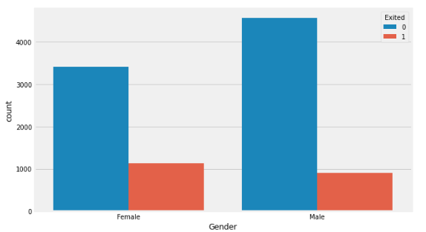
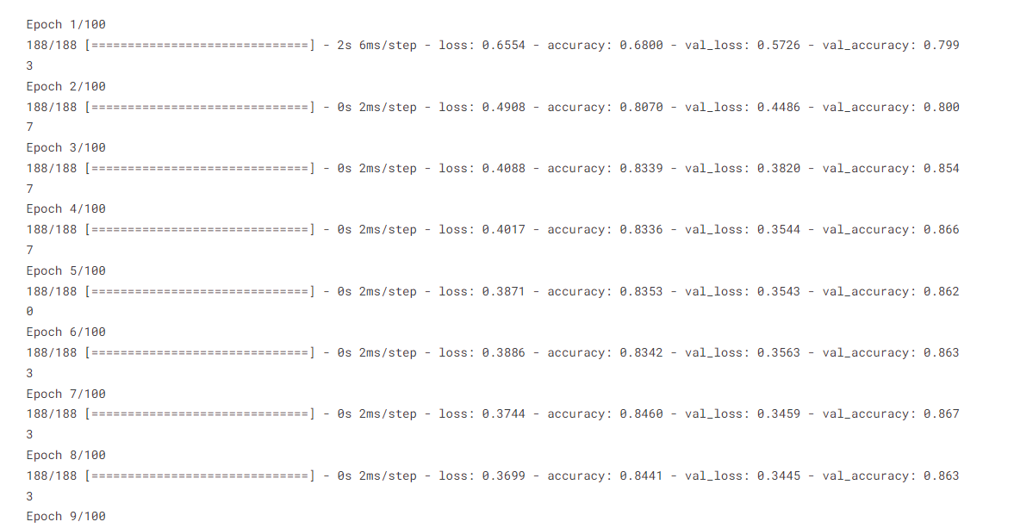
Results and Discussion

Slide 16
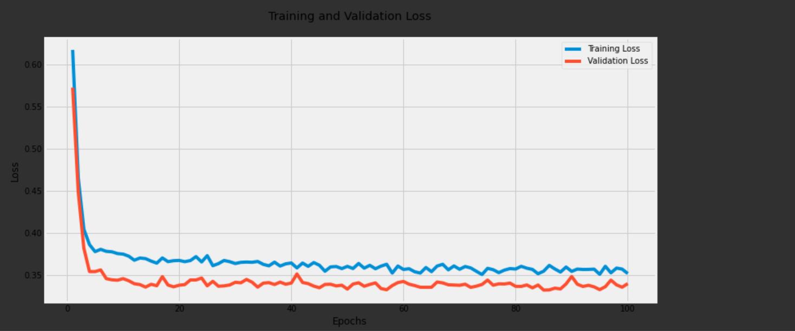
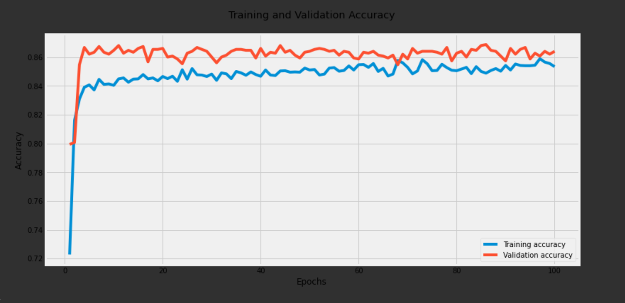
Results and Discussion

Slide 17
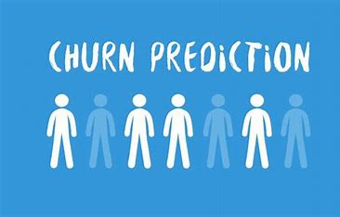
Conclusion
simple decision rules based models and complex classification models for churn prediction task has been proposed in the literature.
require manual feature engineering process which time consuming and error-prone.
dataset used was focused on a customer retention program which included various customer attribute fields and also a column of customer churn.
presented a methodology of using deep-learning models to eliminate the manual feature engineering process.

Slide 18
Contribution
The project contribution is split between three members :
Sai Charan , Sai Prakash , Sai Snusha
Sai Charan – Identifying necessary papers for project implementation
Sai Snusha – Data collection based on column names required for project
Sai Prakash – Code implementation

Slide 19
References
M. Xi, Z. Luo, N. Wang, and J. Yin, “A latent feelings-aware rnn model for user churn prediction with behavioral data,” ArXiv, vol. abs/1911.02224, 2019.
[2] C. Mena, A. D. Caigny, K. Coussement, K. W. D. Bock, and S. Lessmann, “Churn prediction with sequential data and deep neural networks. a comparative analysis,” ArXiv, vol. abs/1909.11114, 2019.
[3] O. Adwan, H. Faris, K. Jaradat, O. Harfoushi, N. Ghatasheh, and K. Abdullah, “Predicting customer churn in telecom industry using multilayer preceptron neural networks : Modeling and analysis,” 2014.
[4] I. Ullah, B. Raza, A. K. Malik, M. Imran, S. U. Islam, and S. W. Kim, “A churn prediction model using random forest: Analysis of machine learning techniques for churn prediction and factor identification in telecom sector,” IEEE Access, vol. 7, pp. 60 134–60 149, 2019.
[5] Özer Çelik and U. OSMANOGLU, “Comparing to techniques used in ˘ customer churn analysis,” Journal of Multidisciplinary Developments, vol. 4, no. 1, pp. 30–38, 2019.
[6] I. Bose and X. Chen, “Hybrid models using unsupervised clustering for prediction of customer churn,” Journal of Organizational Computing and Electronic Commerce, vol. 19, no. 2, pp. 133–151, 2009.
[7] B. A. Tama, “Data mining for predicting customer satisfaction in fastfood,” 2015. [8] V. L. Miguéis, D. V. D. Poel, A. Camanho, and J. F. E. Cunha, “Predicting Partial Customer Churn Using Markov for Discrimination for Modeling First Purchase Sequences,” Working Papers of Faculty of Economics and Business Administration, Ghent University, Belgium 12/806, Aug. 2012.

Slide 20
THANK YOU

